Slide 1
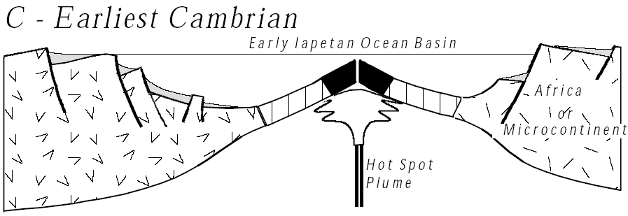
Opening of the Proto-Atlantic (Iapetus) Ocean Earliest Cambrian; 570 - 560 mya
Notes:
Several of the late Proterozoic rift valleys (like the Ocoee) failed to spread into ocean basins and thus became aulacogens. But in Virginia the late Proterozoic axial rift in the Blue Ridge Province opened to form the Proto-Atlantic ocean in the earliest Cambrian.

Slide 2
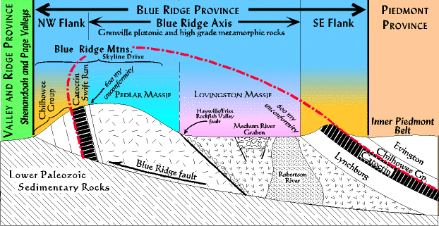
Notes:
Evidence that the late Proterozoic axial rift in the Blue Ridge Province fully opened to form an ocean comes fact that Catoctin lava flows on the northwest limb of the overturned anticline have evidence of forming on land, but those on the southeast limb are often pillow basalts, indicating formation under water. Thus the southeast limb pillow basalt flows likely were extruded in the sea water filling the axial rift.

Slide 3
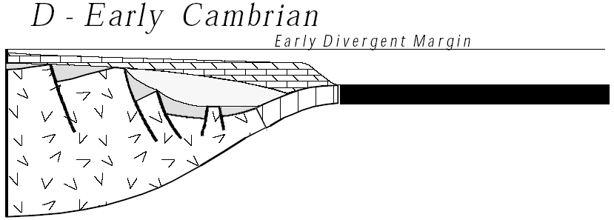
Early Divergent Continental Margin Early Cambrian; 560 - 550 mya
Notes:
The budding ocean was bordered by divergent continental margins starting in the early Cambrian.

Slide 4
Great Smokey
Shenandoah
Acadia
Closing
Collision Orogeny
Peneplanation
Rifting
DCM Sedimentation
Opening
Notes:
Since Shenandoah National Park only encompasses the Blue Ridge province, no rock record of Paleozoic DCM sedimentation exists there. Paleozoic DCM strata is, however, well represented in the Valley and Ridge province which is adjacent to Shenandoah and also comprises the northwestern portions of Great Smokey National Park.

Slide 5
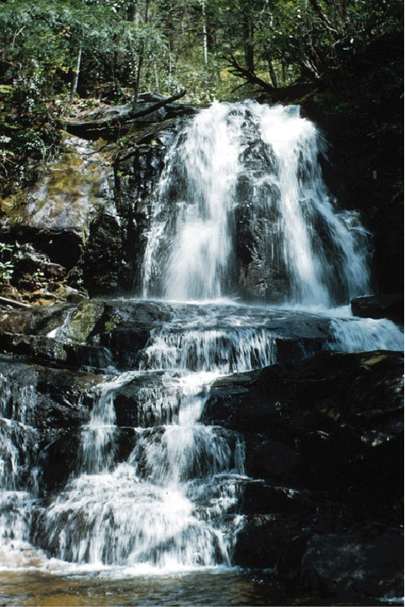
Great Smoky Mountains National Park, Tennessee/North Carolina
Late Proterozoic Thunderhead Sandstone
(rifting starts earlier to south)
W. B. Hamilton, U. S. Geological Survey
Parks and Plates
©2005 Robert J. Lillie
Notes:
Apparently rifting started earlier in southern Appalachians. Remember the Late Proterozoic Thunderhead Sandstone we mentioned in reference to waterfalls in Great Smokey National Park? Well it deposited as relatively deepwater turbidites in a rift valley that must have been submerged at the time.

Slide 6
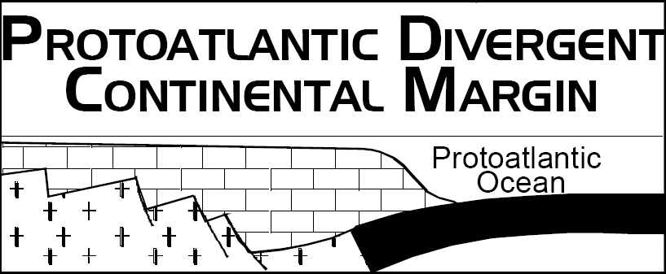
Notes:
Once begun, rifting quickly (10's of millions of years) opens an ocean basin hundreds, then thousands of km wide. As this occurs the source of heat that initially lifted, stretched, and broke the region to form the horsts and grabens remains in the center of the newly forming ocean basin, and thus moves farther and farther away from the new divergent continental margin. As a result the DCM cools, becomes denser, and sinks. Soon the rugged topography of the rift system smoothes out, both by erosion of the horsts, and the filling of the graben. All this happens quickly; the transition from rugged horst mountains to sinking of the continental terrace takes less than 5 million years. The early DCM officially begins when the edge of the continent finally subsides below sea level.

Slide 7
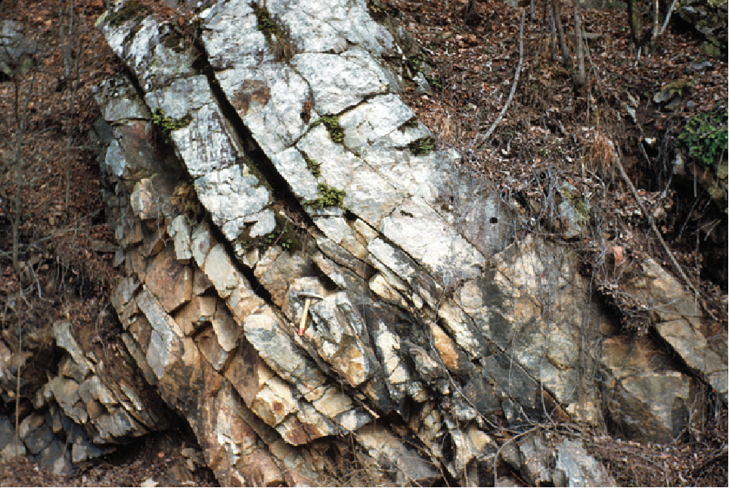
Ancient DCM Strata
(quartz sandstone)
W. B. Hamilton, U. S. Geological Survey
Great Smoky Mountains National Park, Tennessee/North Carolina
Parks and Plates
©2005 Robert J. Lillie
Notes:
This transition is marked in the stratigraphic record a beach deposit of quartz sandstone, that began to migrate, or transgress, across the continent with the subsidence of the continental edge. The transgression will end in Wisconsin in about 100 million years.

Slide 8
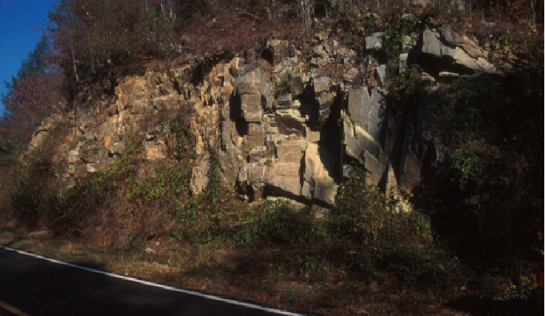
Ancient DCM Strata
(Cambrian)
Blue Ridge Parkway, North Carolina
Robert J. Lillie
Parks and Plates
©2005 Robert J. Lillie
Notes:
Carbonates cover the transgressive quartz sandstone later in the Cambrian but without the intervening shale which is so typical of DCM sedimentation. The rapid transition from pure quartz sandstone to carbonates, without intervening shale, is an indication of how quickly the rift stage stabilized into the early divergent continental margin.

Slide 9
The Lower Paleozoic Divergent Continental Margin And the Chopawamsic Volcanic Arc Middle Cambrian and Lower Ordovician; 570 - 490 mya
Notes:
Following the late Proterozoic/early Cambrian rifting a nearly 120 million-year period of tectonic quiet settled in along the east coast of North America. During this time the continental edge, subsiding quickly at first and then ever more slowly, continuously accumulated enough sediments to keep the water shallow. The result is a wedge of sediments, thin toward the craton and becoming many kilometers thick toward the Proto-Atlantic ocean.

Slide 10
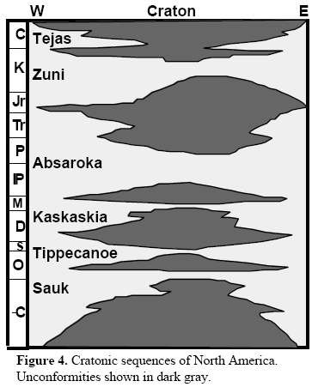
Notes:
In addition, sea level rose world wide more or less continuously throughout this time, creating in North America what is known as the Sauk sea. You should recall from our study of the Grand Canyon, that the Cambrian to Early Ordovician marked the time of the “first great transgression” …

Slide 11
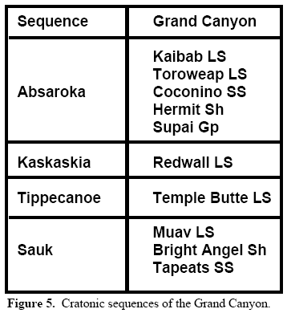
KNOW THE CANYON’S HISTORY
STUDY ROCKS TRULY MADE BY TIME
Notes:
… and was recorded in the “Made By Time” sequence above, below and including the Tonto Platform.

Slide 12
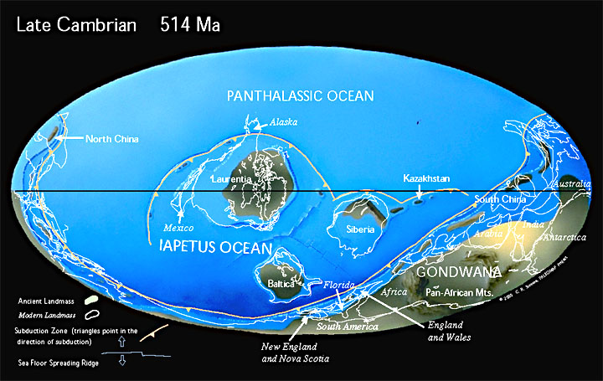
Notes:
When the great transgression had ceased in the early Ordovician, virtually all of the United States was under water. The only exposed parts were central Canada, and a series of low islands across the center of the continent known collectively as the transcontinental arch. Throughout this time eastern North America lay 20-30 degrees south of the equator. Warm tropical waters, plus an absence of continental sources to supply sandstones and shales, led to carbonate deposition (limestones and dolomites) many thousands of feet thick.

Slide 13
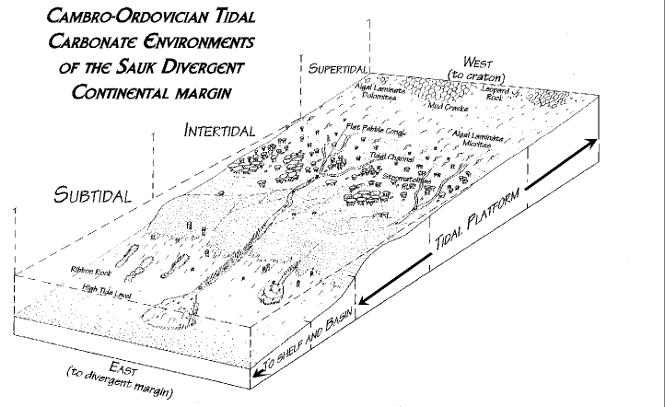
Closer moon made tidal range greater
Notes:
These rocks were deposited in vast tidal flats. The vast extent of the tidal deposits not only in thickness but existing all across eastern North America tells of large, powerful tides. These existed in part because in the Cambrian the moon was closer to the earth than it is now, and tidal attractions were stronger. We can envision a surge of water, a tidal bore, perhaps several feet high rushing rapidly across western Virginia each day, and then draining off again.

Slide 14
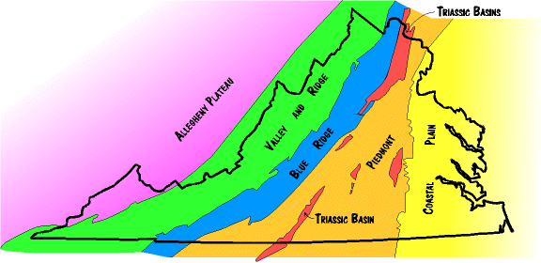
Notes:
These Cambrian and Ordovician carbonate rocks are now exposed throughout the Valley and Ridge province. They are largely responsible for the good farmland in these regions.

Slide 15
Collision of Chopawamsic and Arvonia Volcanic Arcs Late Cambrian; 540 - 435 mya
Notes:
The Lower Paleozoic divergent continental margin will remain tectonically quiet for about 100 my. Each day the tide will move in, and then out, millions of times, then tens of millions of times, and then hundreds of millions of times. Unrelenting geologic boredom…. Out in the Proto-Atlantic ocean, however, other events are taking place that will eventually become a part of Appalachia's history. We observe the beginning of these events with the Chopawamsic volcanic arc in the center of the cross section.

Slide 16
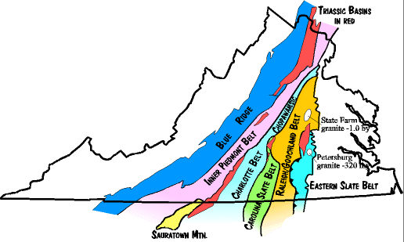
Paleozoic Suspect Terranes in the Piedmont of Virginia
Notes:
This arc of Middle Cambrian age is now firmly attached to Virginia (located in the narrow Chopawansic strip in northern Virginia), but as a tectonostratigraphic terrane, most of its history took place elsewhere. In the late Cambrian eastern North America is still a tectonically stable Divergent Continental Margin. Subsidence has slowed considerably by this time …

Slide 17
Carbonate Scientists Anonymous
Notes:
… and unless you are interested in carbonate rocks not much is happening. Lime love is an east coast malady, in my opinion.

Slide 18
Collision of Chopawamsic and Arvonia Volcanic Arcs Late Cambrian; 540 - 435 mya
lime lovers look here
all others look here
Notes:
Anyway, back to that Late Cambrian arc somewhere in the Proto-Atlantic. In this history the Chopawamsic Arc collides with a microcontinent, becomes inactive and erodes to expose its plutonic roots. About 50 my after the Chopawamsic-microcontinent collision …

Slide 19
East-dipping subduction beneath Chopawamsic - Arvonia Volcanic Arcs Early Ordovician; 500 - 450 mya
Notes:
… a new subduction zone is initiated beneath the eroded Chopawamsic Arc and a new arc forms called Arvonia. Perhaps as a result of these tectonic events (and/or others) …

Slide 20
transgression
regression
Notes:
… worldwide sea level falls, and the Sauk sea regresses. But sediment accumulation in ocean basins will reverse the regression in the mid- to late Ordovician and the Tippecanoe sea will transgress across the entire craton. Thus carbonate deposition will continue on the DCM …

Slide 21
East-dipping subduction beneath Chopawamsic - Arvonia Volcanic Arcs Early Ordovician; 500 - 450 mya
Notes:
… until the amalgamated Chopawamsic and Arvonia terranes collide with the North American DCM in the mid- to late Ordovician …

Slide 22
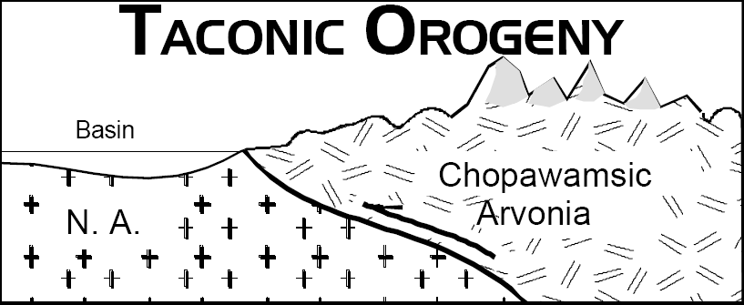
Notes:
… causing the Taconic Orogeny. Because the subduction zone was dipping eastward it acted like a ramp, and the amalgamated terrane was forced to slide up onto and over the continental edge forming the Taconic mountains …

Slide 23
Notes:
… in what is now the Piedmont province. The Taconic mountains have long since eroded but their roots remain today in the Piedmont province …

Slide 24
Paleozoic Terranes in the Piedmont of Virginia
Notes:
… where a collage of tectonostratigraphic terranes preserve a record of the complex orogeny. Most notable here are the Inner Piedmont Belt representing the Proto-Atlantic rift basins and the Charlotte/Chopawamsic belt representing the accreted Arvonia/Chopawamsic amalgamated terrane. Other terranes by other names in other places probably also contributed to the orogeny. It is not really clear whether they all came in together, or came in piece by piece.

Slide 25
Foreland basin
Hinterland
Notes:
At any rate, as the Taconic Mountains rose up, the craton to the west was pressed down into a deep-water foreland basin. The overriding terrane that forms the mountain is the hinterland.

Slide 26
Notes:
The mountains of the Taconic hinterland will eventually erode, but the record of their existence will be well-documented in the foreland basin, which fills with sediments derived from the mountains’ erosion. By the time the basin is full the mountains are completely eroded to sea level. The former mountain becomes flat, featureless, and stable. The terrane is now solidly welded to North America and the orogeny is over. Looming on the horizon, however, is the Avalon terrane, which will collide at a later time as the Acadian orogeny. For now, let’s stay focused on the Taconic orogeny, which is, in fact, a more complicated affair than described in this simple summary, for several reasons.

Slide 27
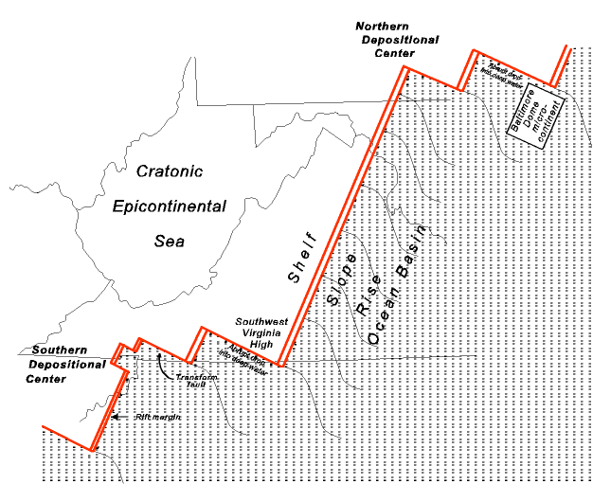
Notes:
First, the eastern edge of North America in the Cambro-Ordovician was rifted into a zigzag. Parts like the Southwest Virginia High and the southeastern Pennsylvania promontory stick out, and get hit hardest. In between are protected “reentrants” where collision is soft. There is no way for something to collide with this coast line uniformly.

Slide 28
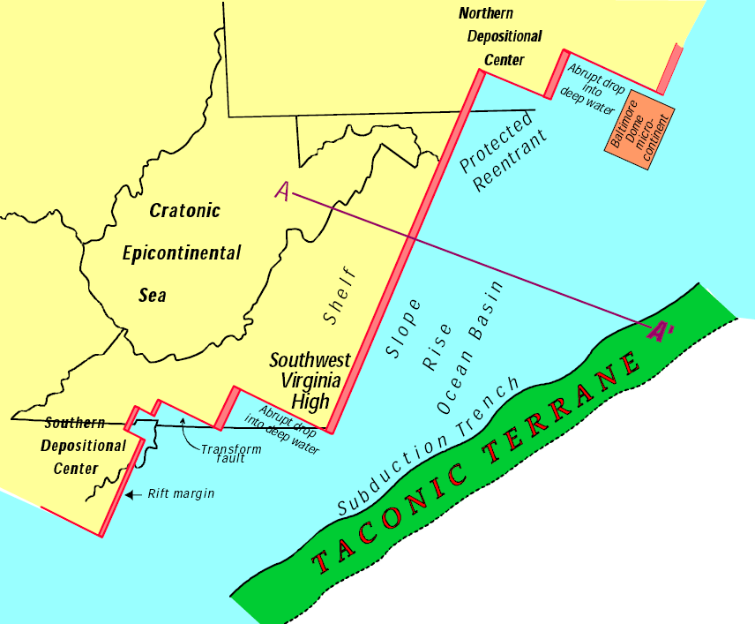
Notes:
Second, the Taconic terrane does not come straight on to North America. It approaches at an angle from the southeast, insuring it will not hit uniformly. Third, the Taconic terrane collides first in southwest Virginia and then a few million years later with southeast Pennsylvania. In effect the orogeny occurs in pulses and has a different character in different places.

Slide 29
Paleozoic Terranes in the Piedmont of Virginia
Notes:
It is also possible that the different belts that make up the Taconic terranes …

Slide 30
Multiple Terrane Collisions?
Notes:
… came in and collided at different times.

Slide 31
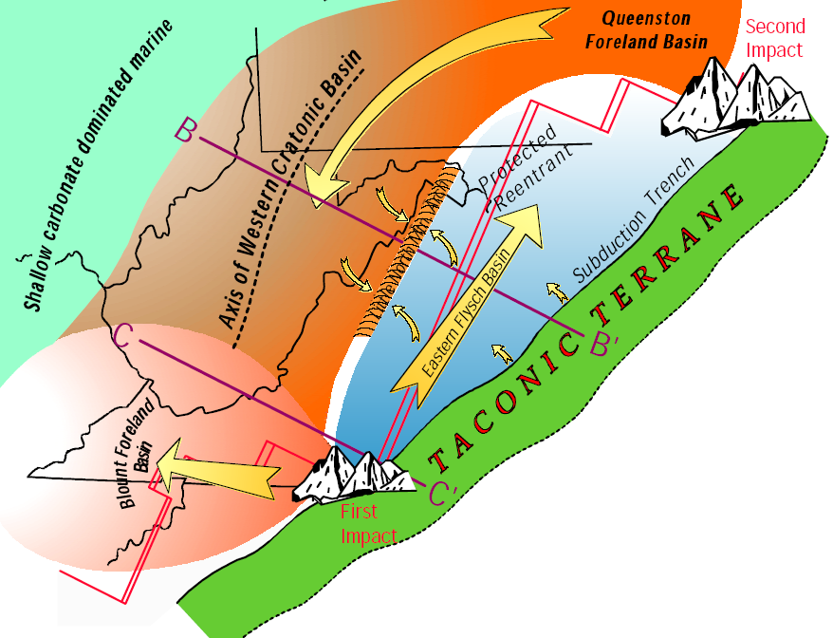
Notes:
The result of all this is that the Taconic orogeny is complicated. The points of major collision result in major thrust mountains, …

Slide 32
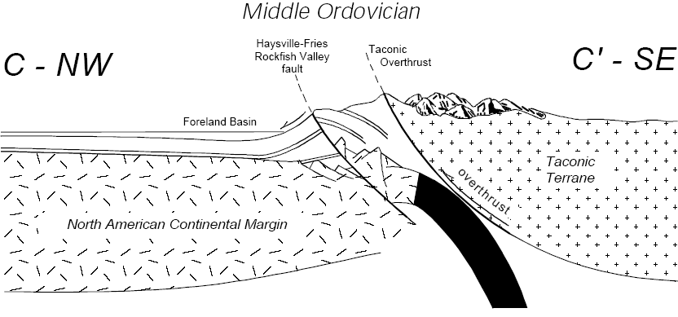
Major collisions result in major thrust mountains
Notes:
… probably as high as the Swiss Alps.

Slide 33
Protected areas get squeezed (not crushed)
Notes:
But the areas in between (northwest Virginia and Maryland for example) are in a protected reentrant, and get squeezed, but not crushed.

Slide 34
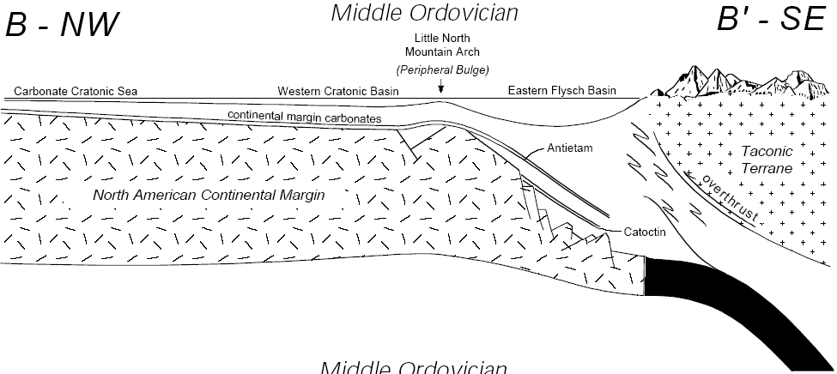
Gentle folding (probably below sea level)
Notes:
Deformation here is gentle folding into an arch that may never have risen above sea level.

Slide 35
Taconic Setup
Oblivious carbonates
Active volcanoes
Notes:
The orogeny begins when the Taconic terrane converges on the Southwest Virginia High from the southeast. Along the western border of the terrane oceanic lithosphere is descending down a subduction zone, keeping the volcanoes in the terrane active. Between the terrane and the continent edge is the Proto-Atlantic remnant ocean basin (ROB), quickly disappearing down a subduction zone. When it is gone, the continent and terrane will collide. For the time being, carbonates rocks continue to flourish throughout the tectonically stable and climatically tropical Mid-Atlantic - completely oblivious to the “terrane-wreck” [sic] approaching on the horizon. Had they noticed the wisps of volcanic ash blowing past them on the trade winds from the still active volcanoes in the Taconic terrane, perhaps the carbonate-depositing, reef-building creatures would have moved to safer digs.

Slide 36
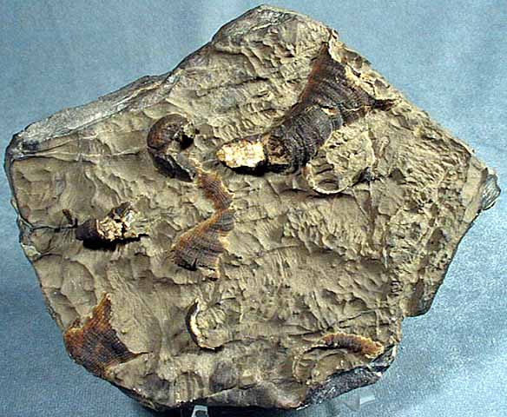
Notes:
But coral, brachiopods, and sponges are not known for their keen geological awareness or mobility for that matter.

Slide 37
I told you all it was ash!! But does anyone ever listen to me?!! NOOOO! Now just look at us!
Notes:
…

Slide 38
Foreland
Hinterland
Notes:
As the last of the remnant ocean basin descends into the subduction zone the terrane finally collides with the Southwest Virginia high, sticking so prominently out into the Proto-Atlantic. With the collision the terrane becomes a hinterland, …

Slide 39
Foreland basin
Notes:
… while inland from the first impact a foreland basin develops, the “Blount”. Actually there will be several foreland basins before all is said and done, but this is the first.

Slide 40
Terrane swings around
Notes:
A few million years after the first impact, the Taconic terrane wraps around and collides for a second time with southeastern Pennsylvania, building a second hinterland mountain. The “Queenston” foreland basin develops to the west in central Pennsylvania.

Slide 41
Flysch basin
Peripheral bulge
The Protected Reentrant
Notes:
With the Taconic terrane now hung up on the two promontories it stops moving. In between the two collision points lies a protected reentrant, set back too far from the terrane to undergo major deformation. The reentrant is not unscathed, however, and what does happen takes some understanding of subduction zone dynamics. Running in front of a subduction zone on the oceanic side of a trench is a peripheral bulge, an arch in the oceanic floor.

Slide 42
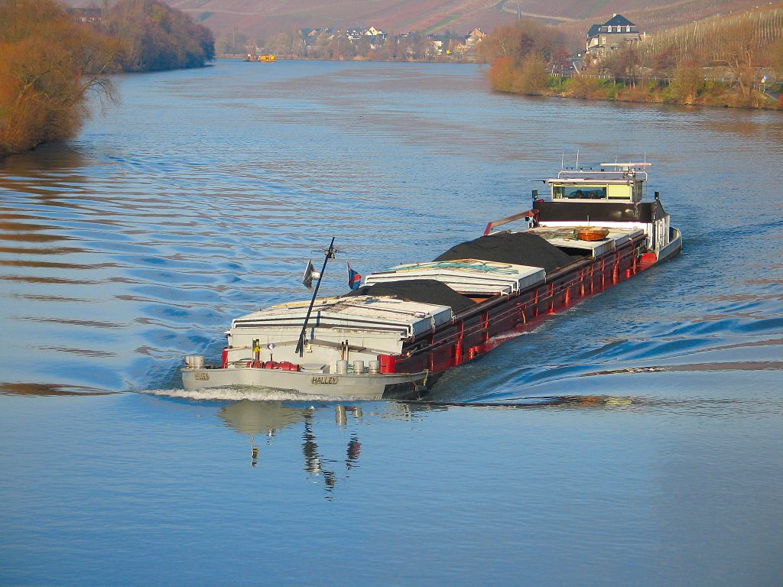
Notes:
This bulge is like a wave continuously running away from the front of a boat.

Slide 43
Flysch basin
Peripheral bulge
The Protected Reentrant
Notes:
In the Ordovician, as the terrane approaches, the bulge is the first thing to hit North America, and it slightly lifts the continent into an arch, moving like a wave inland. At the major impact sites we would see no evidence of the bulge, since it will be destroyed by the rest of the mountain building.

Slide 44
Bulge separates W. Cratonic Basin from E. Flysch Basin
Notes:
But in the reentrant the bulge is preserved (in sediment that is; there is no actual bulge today) as the Little North Mountain arch. The arch divides the protected reentrant into two foreland basins, a Western Cratonic Basin and an Eastern flysch basin. On the east side of the flysch basin the terrane is hung up and acts as a dam sealing the flysch basin off from the ocean on the other side. The Western Cratonic basin is continuous with the shallow Tippecanoe sea covering most of North America at the time, and it also merges north with the Queenston foreland basin.

Slide 45
Rheic Ocean
Notes:
Note that now, with the collision, the Proto-Atlantic ocean has disappeared down the subduction zone. But there is still an ocean east of the terrane. It is the Rheic ocean.

Slide 46
Orogeny ends, mountains erode into flysch and foreland basins
Notes:
With the terrane stopped, the orogeny is now effectively over. No more mountain building can occur. The only thing that remains is for the mountains to erode, and the foreland basins to fill with sediment. But in the Taconic even this is not simple because we have two major sourcelands, one in the north and one in the south (not to mention the terrane blocking the opening of the reentrant), and several foreland basins. From the southern Virginia sourceland sediment spreads out in two directions. One is the Blount clastic wedge (foreland basin) spreading westward through southwest Virginia into Kentucky and Tennessee. The second is the Martinsburg flysch, traveling northeast, down the deep axis of the flysch basin, trapped between the terrane on the east and the Little North Mountain arch on the west. The Martinsburg flysch is made of very immature sediments (rich in feldspar and rock fragments) flowing as deep water turbidity currents (underwater avalanches) down the axis of the basin. These currents flow all the way to Pennsylvania. From the Pennsylvania sourceland, sediment flows westward into the Queenston foreland basin (clastic wedge) in central Pennsylvania. And from there it turns southwestward into the Western Cratonic basin of West Virginia. Some of it encroaches up onto the back side of the Little North Mountain Arch, but none is able to cross over into the flysch basin. Not until the very end, when the basins are full, and the mountains virtually all gone, will sediment spread from one basin into another.

Slide 47
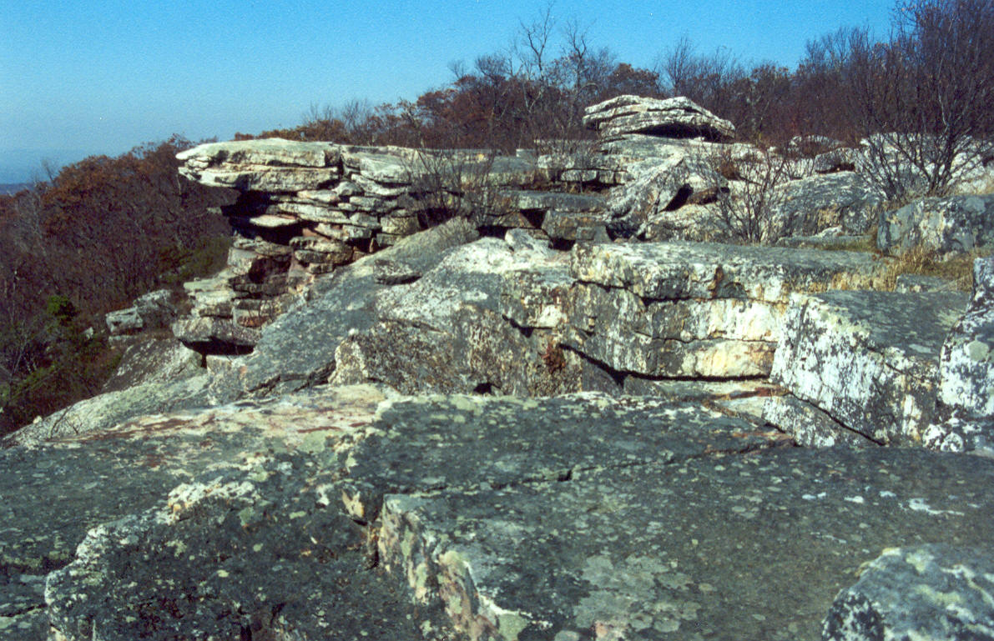
Post orogenic sedimentation (quartz sandstone and carbonate)
Notes:
The end of orogenies in general, and the Taconic in particular are easily recognized in the rock record. Orogenies produce very thick accumulations of immature sediments. But, as the orogeny ends, the supply of immature clastic sediment wanes, and sediments return to non-mountain building types - carbonates and quartz sandstones.

Slide 48
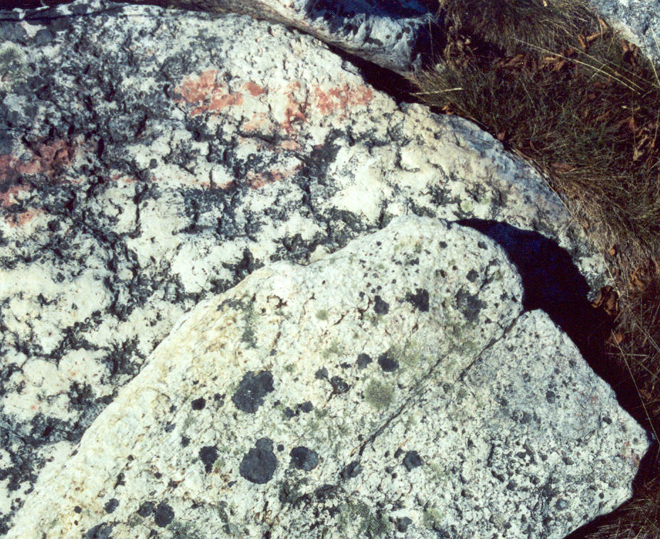
Very little feldspar or clay
Notes:
The end of the Taconic orogeny is marked by an extremely pure quartz sandstone called the Tuscarora that blankets the entire Appalachian region from New York to Tennessee. It contains very little feldspar or clay that would indicate rapid deposition.

Slide 49
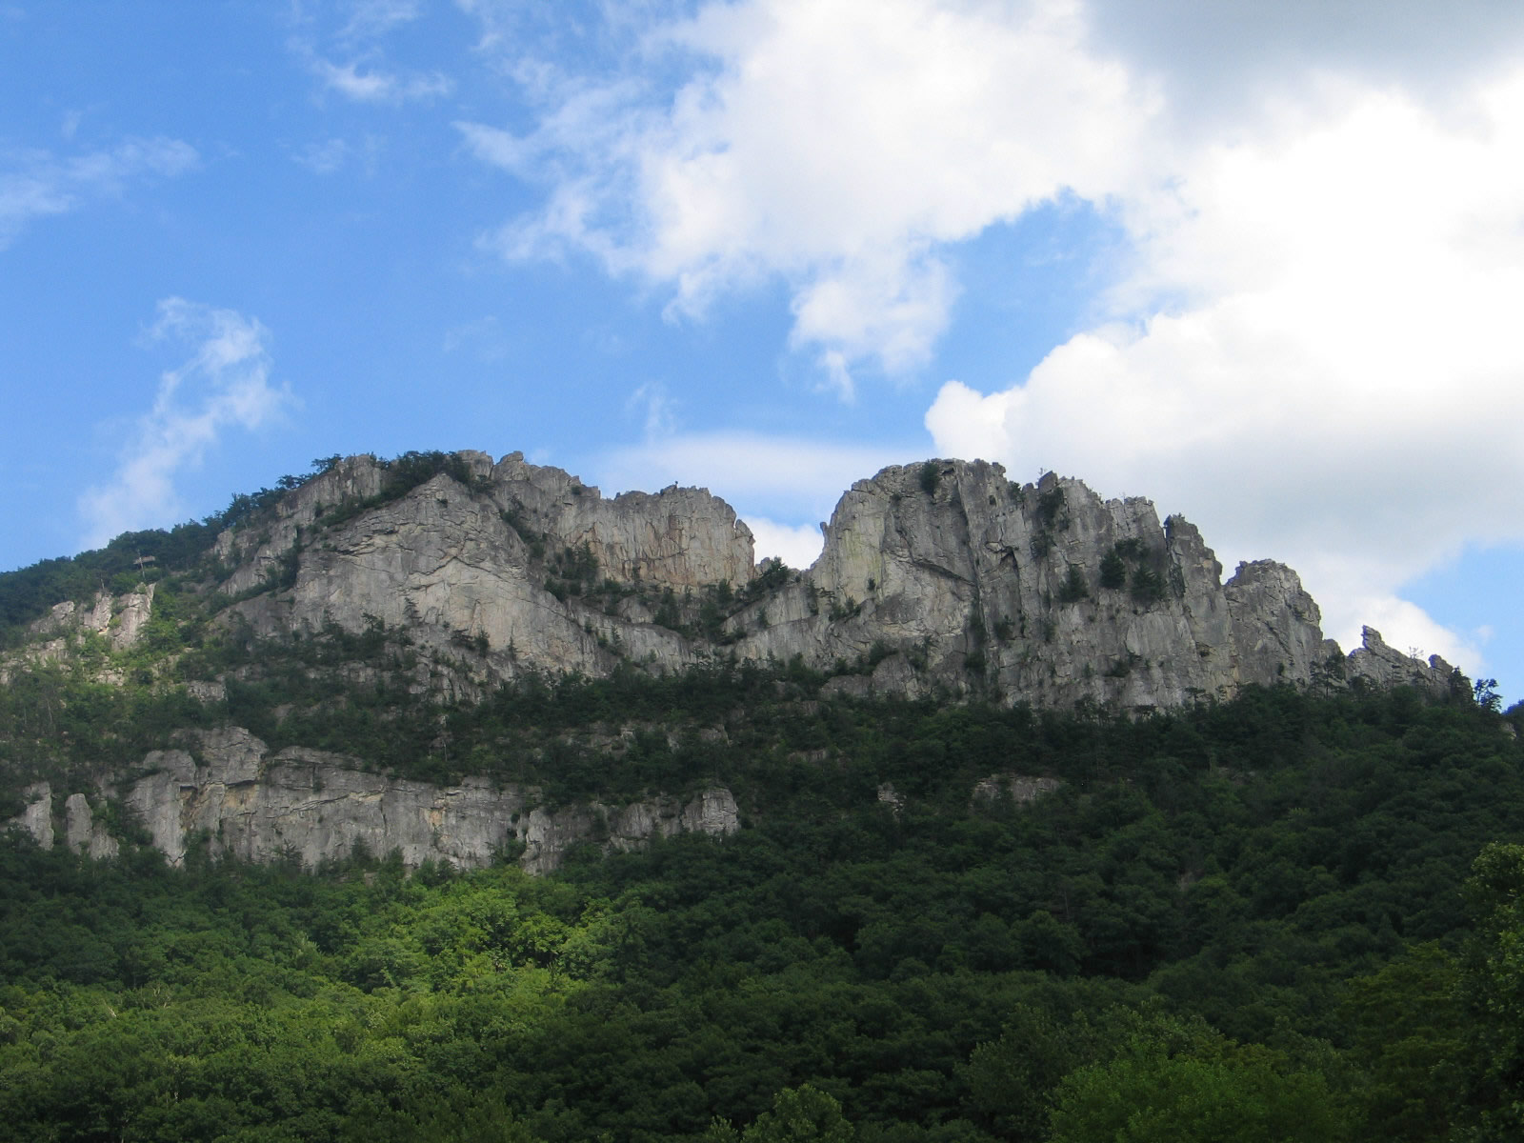
Notes:
Seneca Rocks in W. Virginia highlights the durability of the Tuscarora. The maturity of the sandstone tells us the Taconic mountains have been eroded down to stability. It also tells us all the various foreland basins have filled in to allow the Tuscarora sand to spread more or less uniformly everywhere.

Slide 50
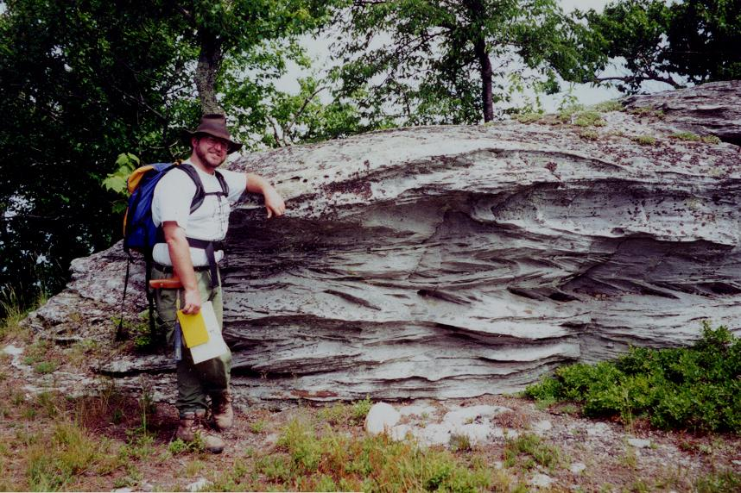
Bidirectional cross bedding is tidal (shallow water)
Notes:
That strong tidal currents helped spread the Tuscarora is indicated by bidirectional cross-bedding. The herringbone-like pattern forms when ebb and flood currents change directions by 180°.

Slide 51
Bidirectional cross bedding is tidal (shallow water)
Bidirectional cross-bedding?!! Do I look like I’m into that?!!
Notes:
…

